Slide 1
Female Reproductive System
The major organs of the female reproductive system include:
Vagina: This muscular tube receives the male gametes during intercourse and through it a baby leaves the uterus during childbirth.
Uterus: This organ holds and nourishes a developing fetus
Ovaries: The female gonads, the ovaries produce ova. When one matures, it is released down into a fallopian tube.
Fallopian tubes: These small tubes transport ova from the ovaries to the uterus. This is where an egg waits to be fertilized.
The two main female sex hormones are estrogen and progesterone.
Although testosterone is considered a male hormone, females also produce and need a small amount of this.
Apart from this LH and FSH has a major role in formation and maturation of ovum and ovulation: release of mature ovum from the ovary
Estrogen is a hormone that plays various roles in the body. In females, it helps develop and maintain both the reproductive system and female characteristics, such as breasts and pubic hair.
Ovaries: Estrogen helps stimulate the growth of the egg follicle.
Vagina: In the vagina, estrogen maintains the thickness of the vaginal wall and promotes lubrication.
Uterus: Estrogen enhances and maintains the mucous membrane that lines the uterus. It also regulates the flow and thickness of uterine mucus secretions.

Slide 2
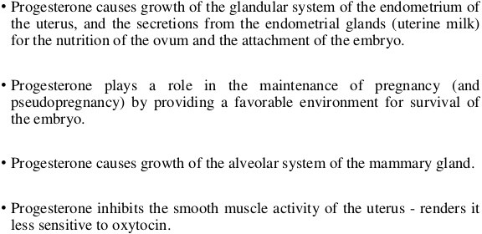
Breasts: The body uses estrogen in the formation of breast tissue. This hormone also helps stop the flow of milk after weaning.
Development of Breasts
Widening of hips
Growth of hair in the armpit and genital areas
Increase in body fat percentage
Starting of menstrual cycle
Menarche is the first menstrual cycle, or first menstrual bleeding, in female humans. From both social and medical perspectives, it is often considered the central event of female puberty, as it signals the possibility of fertility.
The ceasing of menstruation.
A natural decline in reproductive hormones when a woman reaches her 40s or 50s. Menopause is signalled by 12 months since last menstruation.

Slide 3
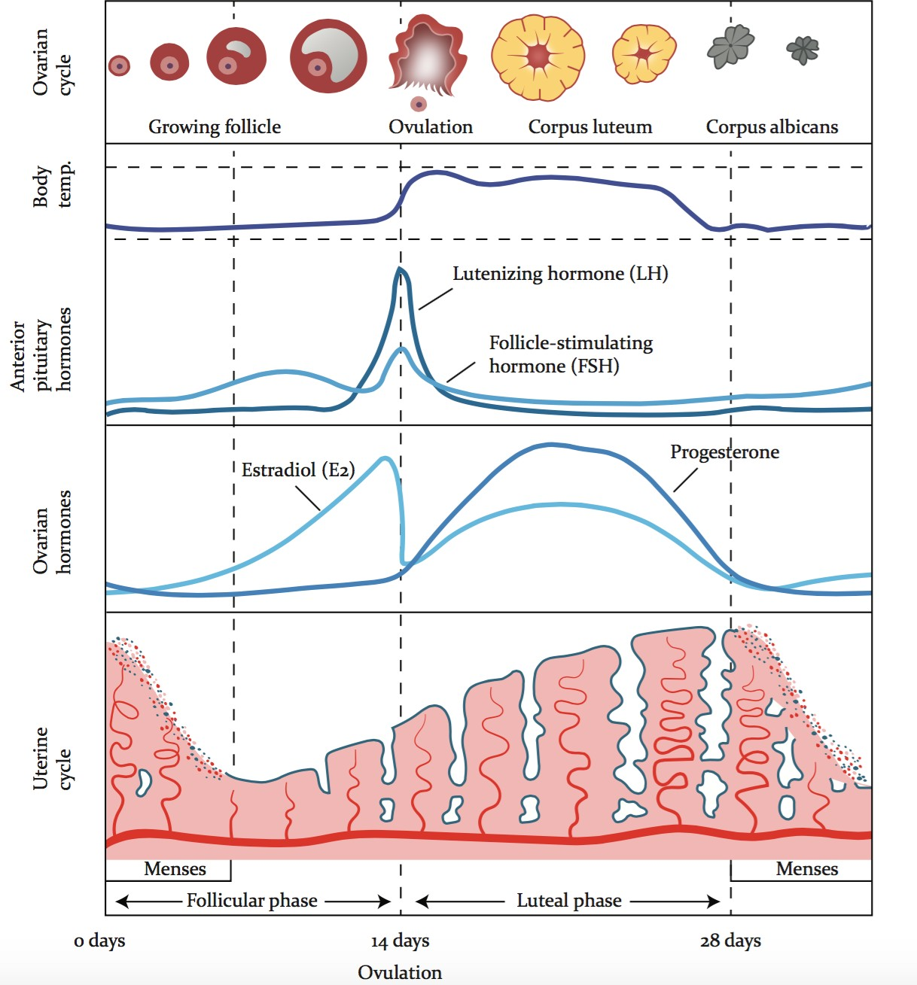
Phases of Menstrual cycle:
Length of the cycle: 28 + 5 days
Menstruation: The period—the shedding of the uterine lining. (1-4days)
Ovulation: Discharge of mature ovum from the ovary (14th day)
Variation is seen in the proliferative phase, Secretory or Luteal phase is 14 days
Oogonium —(Oocytogenesis)—> primary oocyte formation occurs in the embryonic stage
Primary Oocyte —(Meiosis I)—> First Polar body (Discarded afterward) + Secondary oocyte —(Meiosis II)—> Second Polar Body (Discarded afterward) + Ovum
Second polar body is discarded after fertilization, meiosis II completes after fertilization.

Slide 4
HORMONAL CONTROL OF THE FEMALE REPRODUCTIVE CYCLE
The menstrual cycle is regulated by hormones. Luteinizing hormone and
follicle-stimulating hormone, which are produced by the pituitary gland, promote ovulation and stimulate the ovaries to produce estrogen and progesterone. Estrogen and progesterone stimulate the uterus and breasts to prepare for possible fertilization.
The menstrual cycle begins with menstrual bleeding (menstruation), which marks
the first day of the follicular phase.
When the follicular phase begins, levels of estrogen and progesterone are low. As
a result, the top layers of the thickened lining of the uterus (endometrium) break
down and are shed, and menstrual bleeding occurs.
About this time, the follicle-stimulating hormone level increases slightly,
stimulating the development of several follicles in the ovaries.
The ovulatory phase begins with a surge in luteinizing hormone and
follicle-stimulating hormone levels. Luteinizing hormone stimulates egg release
(ovulation), which usually occurs 16 to 32 hours after the surge begins. The
estrogen level decreases during the surge, and the progesterone level starts to
increase.
During the luteal phase, luteinizing hormone and follicle-stimulating hormone
levels decrease. The ruptured follicle closes after releasing the egg and forms a
corpus luteum, which produces progesterone. During most of this phase, the
estrogen level is high. Progesterone and estrogen cause the lining of the uterus to
thicken more, to prepare for possible fertilization.

Slide 5
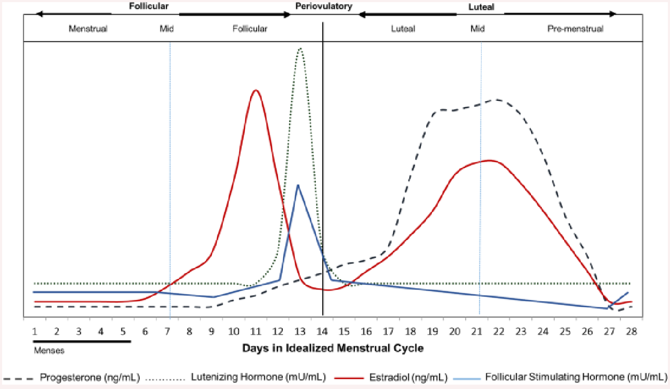
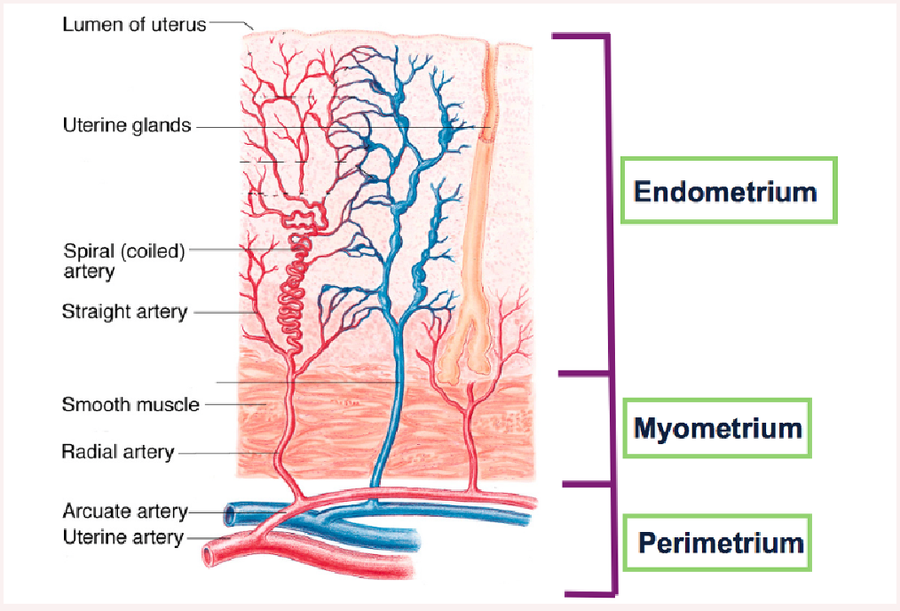
Structure of uterus
The uterus has three layers, which together form the uterine wall. From innermost to outermost, these layers are the endometrium, myometrium, and

Slide 6
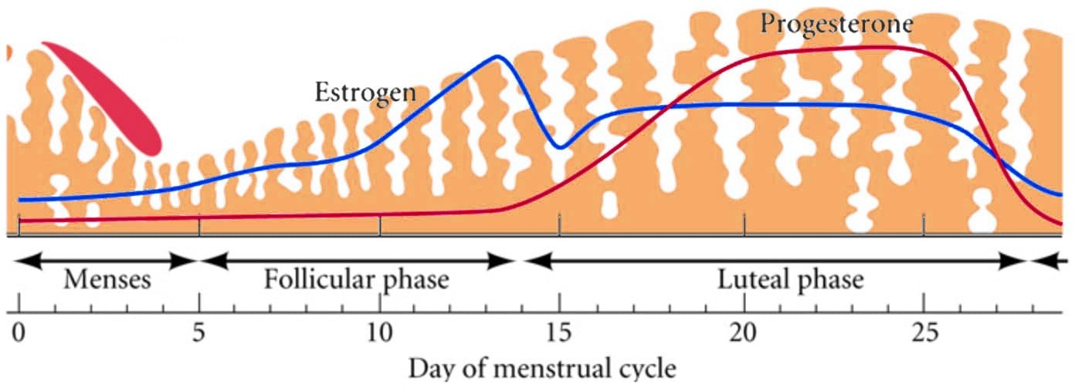
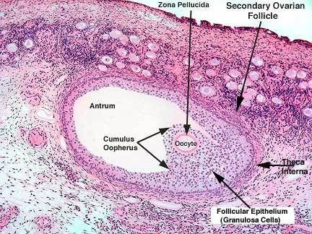
perimetrium. The endometrium is the inner epithelial layer, along with its mucous membrane, of the mammalian uterus.
Uterine changes:
The uterine cycle includes the increase in the endometrium in preparation for implantation and the shedding of the lining following lack of implantation, termed menstruation.
Menstrual cycles are counted from the first day of menstrual bleeding.
Endometrial thickening is stimulated by the increasing amount of estrogen in the follicular phase.
If implantation does not occur, progesterone and estrogen levels drop, which stimulates menstruation.
Histological Structure of ovary:

Slide 7
Ovarian changes during the menstrual cycle:
The ovarian cycle refers to the series of changes in the ovary during which the follicle matures, the ovum is shed, and the corpus luteum develops.
The follicular phase describes the development of the follicle in response to follicle stimulation hormone ( FSH ). As luteinizing hormone ( LH ) and FSH levels increase they stimulate ovulation, or the release of a mature oocyte into the fallopian tubes.
In the luteal phase, the corpus luteum forms on the ovary and secretes many hormones, most significantly progesterone, which makes the endometrium of the uterus ready for implantation of an embryo.
If implantation does not occur, the corpus luteum will be degraded, resulting in menstruation.
If implantation occurs the corpus luteum is maintained.

