Slide 1
Pregnancy and Lactation
Role of Hormones

Slide 2
Pregnancy
Pregnancy is the term used to describe the period in which a fetus develops inside a woman's womb or uterus.
Pregnancy usually lasts about 40 weeks, or just over 9 months, as measured from the last menstrual period to delivery.
Pregnancy occurs when a sperm fertilizes an egg after it's released from the ovary during ovulation. The fertilized egg then travels down into the uterus, where implantation occurs. A successful implantation results in pregnancy.

Slide 3
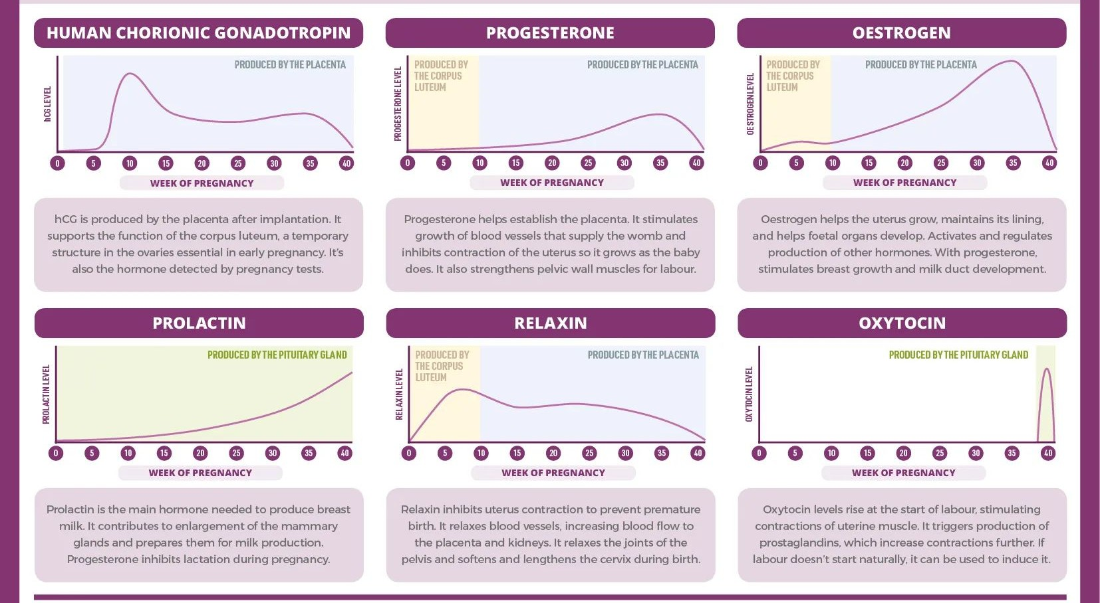

Slide 4
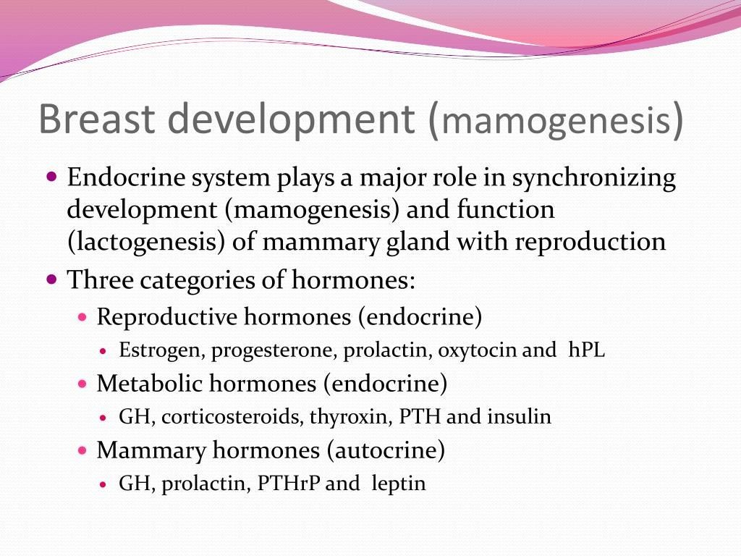

Slide 5
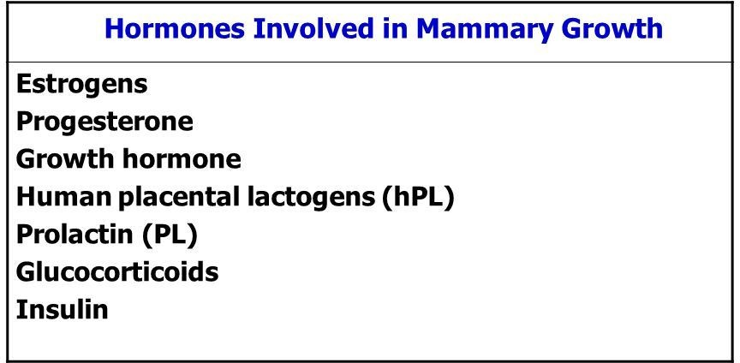

Slide 6
